Slide 1
Spark Basics
Spark Context
Resilient Distributed Dataset (RDD)

Slide 2
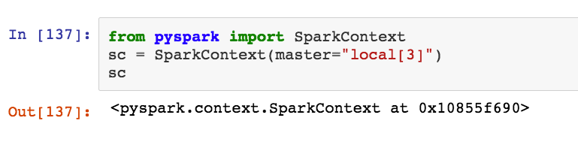
Spark Context
Spark is complex distributed software.
The python interface to spark is called pyspark
SparkContext is a python class, defined as part of pyspark which manages the communication between the user's program and spark.
We start by creating a SparkContext object named sc.

Slide 3
Resilient Distributed DataSets (RDDs)
Driver Node
Worker Node1 (CPU)
Worker Node3 (CPU)
Driver Program
(Python)
Executor 1
Worker Node2 (CPU)
Executor 3
RDD1
partitions1
RDD2
partitions1
Executor 2
RDD1
partitions3
RDD2
partitions3
RDD1
RDD2
RDD1
partitions2
RDD2
partitions2
Spark Context
(Scala)
Driver node
Driver Program
Spark Context
RDDs
Partitions
Executors

Slide 4
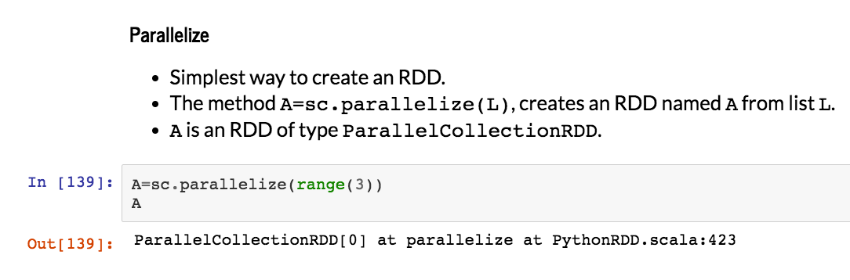

Slide 5
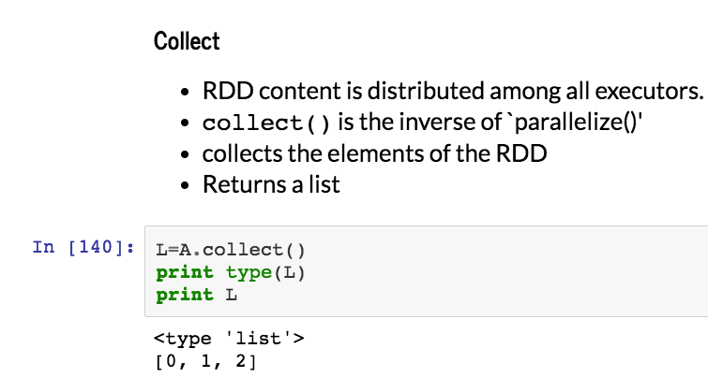

Slide 6
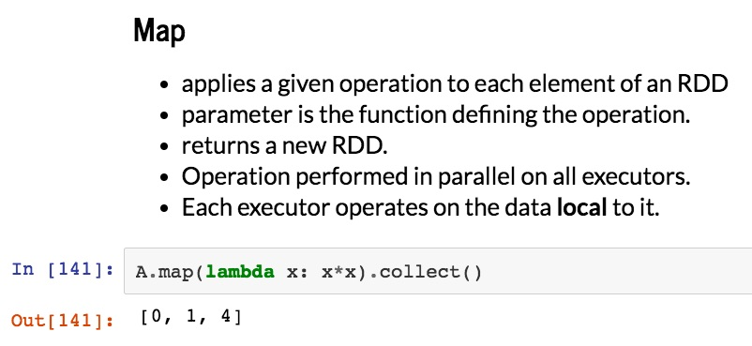

Slide 7
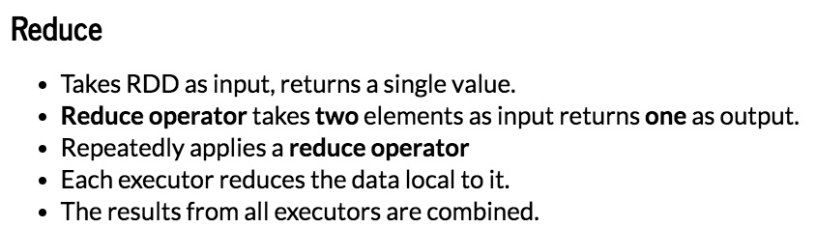

Slide 8
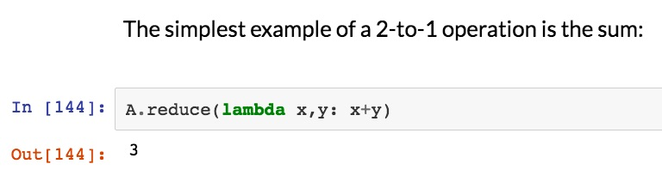

Slide 9
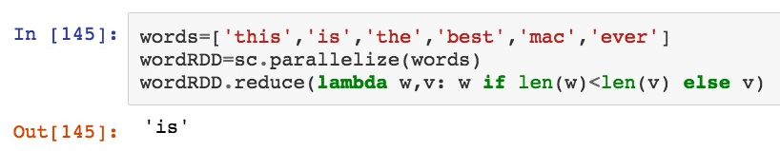
Another example:
Find the shortest word in a list

Slide 10
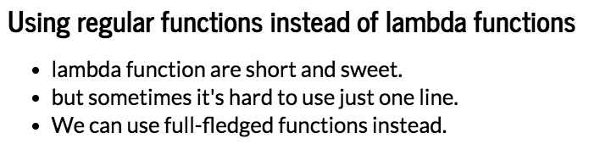

Slide 11
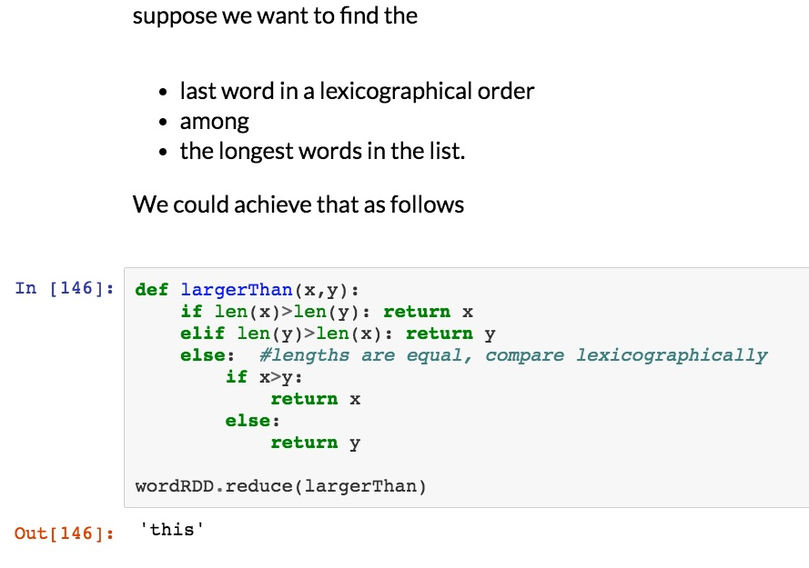

Slide 12
Summary
Spark - Context
RDDs
Map
Reduce
More details, and excercises, in the jupyter notebook.
Next time: more about RDDs

